Slide 1
WORK IN PROGRESS PRESENTATION
Rishita, Khush, Xiang

Slide 2
DATASET
Our dataset consists of information regarding 32,833 Spotify tracks authored by Charlie Thompson, Josiah Parry, Donal Phipps, and Tom Wolff and was found through TidyTuesday.
It includes multiple audio features such as track popularity, loudness, liveliness, energy, etc. Throughout this project, we plan on exploring relationships between multiple attributes.

Slide 3
VISUALIZATIONS

Slide 4
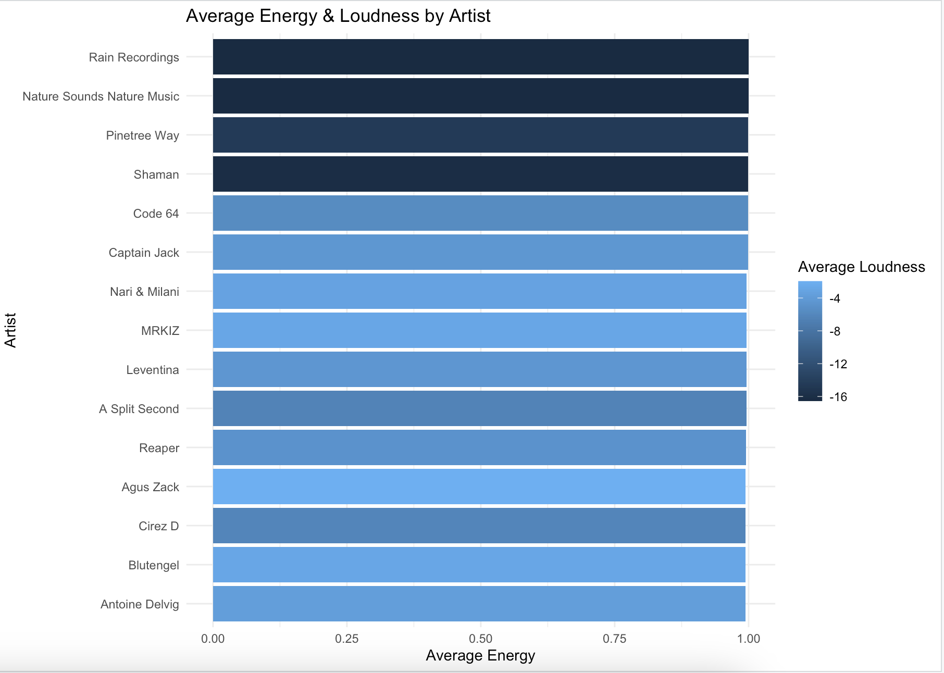
A bar chart showing average energy by artist with a color gradient for loudness.

Slide 5
TAKEAWAYS
We noticed that the top 15 artists have the same average energy but differ in average loudness.
The loudness varies from -4 LUFS(Loudness Units Full Scale) to -16 LUFS.
We can expand on this observation by categorizing these artists by genre to gather information on how each genre differs in loudness.

Slide 6
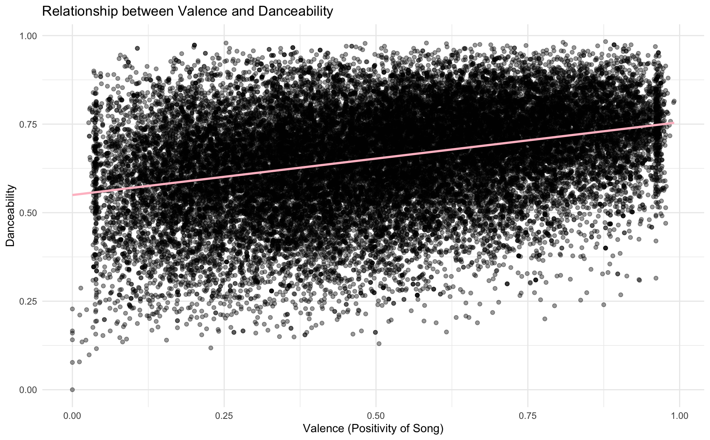
Scatter plot showing the relationship between valence and danceability with a positive trend line.

Slide 7
TAKEAWAYS
There is a clear positive linear relationship between the two variables, leading us to the conclusion that happier songs tend to be more danceable.
Songs with lower valence tend to be at the bottom and those with higher valence are closer to the top.
One possible drawback is that there are many potential outliers since certain sad songs tend to be danceable too.

Slide 8
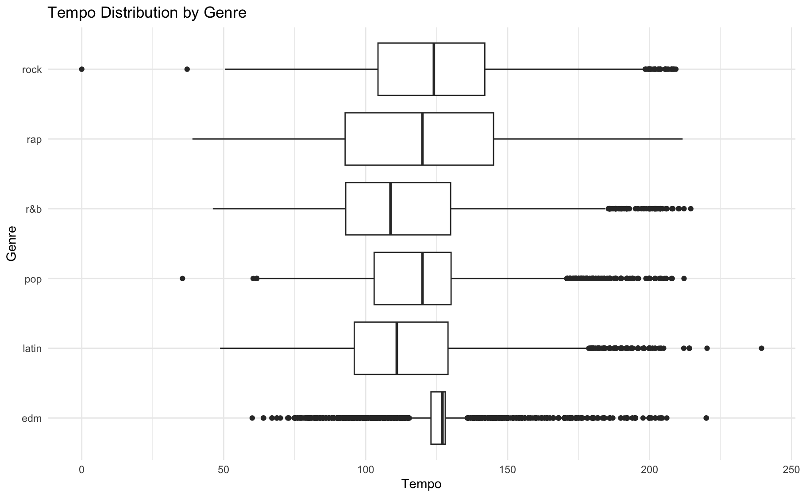
Box plot chart showing tempo distribution by music genre with six genres: rock, rap, r&b, pop, latin, and edm.

Slide 9
TAKEAWAYS
We observed that all six genres have different levels of tempo.
EDM and Pop genres tend to have the highest tempo and R&B has the lowest.
We plan on redoing this visualization as a density plot or something similar to make it easier to make observations.

Slide 10
CHALLENGES
Since the dataset is relatively large, it was hard to create visualizations that included all 32,833 tracks.
To work through this issue, we used the slice() function to select only a few columns.
For example, in the Average Energy & Loudness by Artist visualization, we filtered to the top 15 artists.

Slide 11
NEXT STEPS
We will ensure that our data is properly wrangled.
We’ll continue working on and expanding our current visualizations and create well-formatted tables and other visualizations to fully understand the relationships between the audio features.
Some examples include:
Tempo through the years
Which features determines popularity best
Artist profiles (audio features for different artists)
Submit our final project as a well-organized, reproducible report.

Slide 12
RESEARCH QUESTIONS
1. How do different audio features relate to each other?
2. Which features best predict track popularity?
3. How do musical attributes differ across genres?
4. How do tempo or energy levels change over time?

Slide 13
THANK YOU
Questions?

